Slide 1
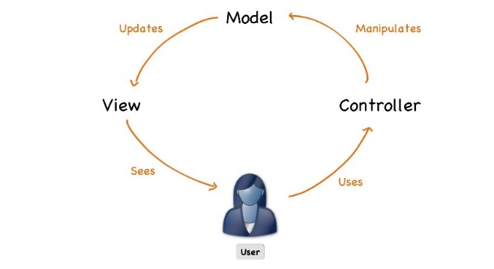



ASP.NET Fundamentals
Course Introduction
SoftUni Team
Technical Trainers
Software University
https://softuni.bg

Slide 2
Table of Contents
Course Objectives
Training and Team
Course Organization
Course Infrastructure
Evaluation Criteria

Slide 3
Have a Question?
sli.do
#csharp-web

Slide 4













SoftUni Diamond Partners

Slide 5

Educational Partners

Slide 6

Course Objectives

Slide 7
ASP.NET Fundamentals
Web Fundamentals
HTTP Protocol
ASP.NET Fundamentals
ASP.NET and Databases
Cookies and Sessions
ASP.NET Identity
7

Slide 8
ASP.NET Advanced
ASP.NET Core in Depth
Razor View Engine
Security and Identity
Project Architecture
Unit Testing
Control Flow
Deployment and Continuous Integration
8

Slide 9
Practical Programming Exam
1 practical problem for 4 hours
Implementing a simple web application
Solutions are evaluated by hand after the exam
9

Slide 10
Theoretical Exam
You will have 30 minutes once you enter
Multiple-choice with 1 or more correct answers
English
Automated quiz system
Available during the practical exam and 30 minutes after it
You can submit your answers only one time
Advice: Start it when you finish the practical exam
10

Slide 11

Trainers

Slide 12
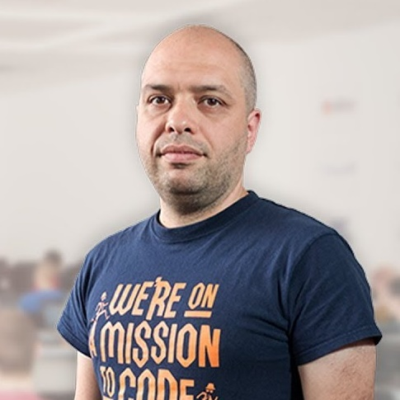
Stamo Petkov
Head Of Department at Information Services Plc.
Worked with various technologies
.NET and C#, BASIC, Pascal, Object Pascal, PHP
More than 15 years of experience
Experienced Lecturer
C# Basics and ASP.NET MVC @ Softuni

Slide 13

Course Organization

Slide 14
ASP.NET Fundamentals Timeline
14-Sep-2022
22-Oct-2022
21-Dec-2022
ASP.NET Fundamentals
5 weeks * 2 times / week
12 credits
Start: 14-Sep-2022
Exam: 22-Oct-2022
Theoretical Exam: 22-Oct-2022
Re-Take Exams: 21-Dec-2022

Slide 15

Course Workflow
Live coding
You no longer have homework
Create ASP.NET Core MVC apps and implement features during the course
Work with GitHub
Groups of lectures are followed by workshops
Knowledge is used to extend an application
Best practices are applied

Slide 16


SoftUni Certificate
Practical Exam 100%
Evaluation
16

Slide 17
CPE Certificate
Practical Exam
Theoretical Exam
Evaluation
17

Slide 18



Course Web Site, Forum and FB Group
Official web site:
Official discussion forum:
Official Facebook groups:
https://softuni.bg/trainings/3853/asp-net-fundamentals-september-2022
https://softuni.bg/forum/categories/66/csharp-web-development-basics
https://www.facebook.com/groups/CsharpWebSeptember2022

Slide 19
Questions?
Notes:
19

Slide 20
Trainings @ Software University (SoftUni)
Software University – High-Quality Education, Profession and Job for Software Developers
softuni.bg, about.softuni.bg
Software University Foundation
softuni.foundation
Software University @ Facebook
facebook.com/SoftwareUniversity
Software University Forums
forum.softuni.bg
20
Notes:
20

Slide 21

License
This course (slides, examples, demos, exercises, homework, documents, videos and other assets) is copyrighted content
Unauthorized copy, reproduction or use is illegal
© SoftUni – https://about.softuni.bg
© Software University – https://softuni.bg
Notes:
21

